Slide 1
Checking understanding of ordering and comparing numbers
Task A: Reviewing the use of <, > and =
In each set of numbers, which has the greater value?
Write a statement using <, > or = to compare the values.
9 9.00
1900
fourteen thousand
9.5 million
9 350 647
1.09 1.4
109 000 140 000
0.4 0.09
0.04 0.019
190 000 1.4 million
19.04 19.104
Write your own comparison statements using the digits 0, 1, 4 and 9. Try to write a statement no one else has thought of.
Use this grid where needed to help align the numbers for easier comparison.

Slide 2
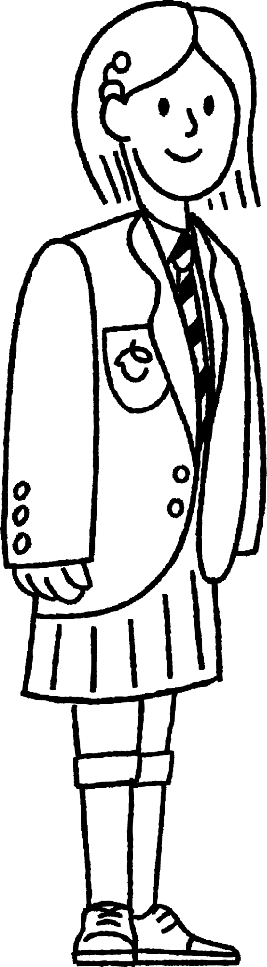
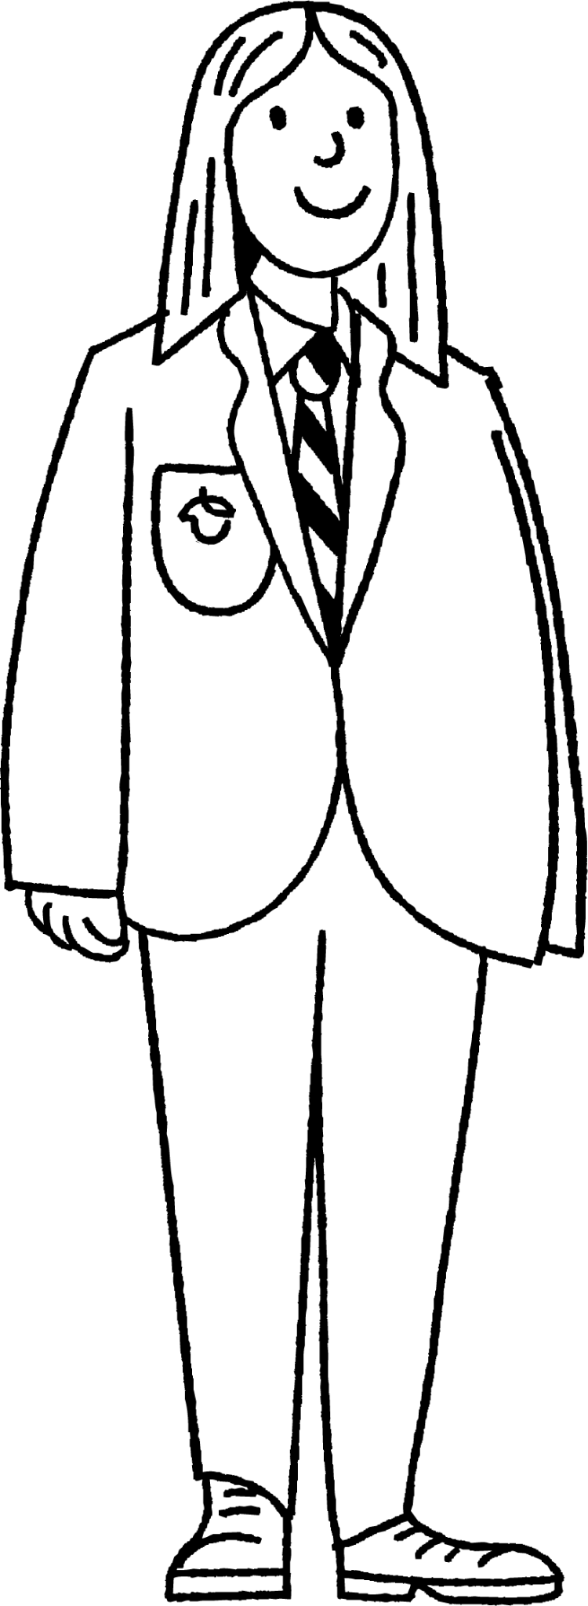
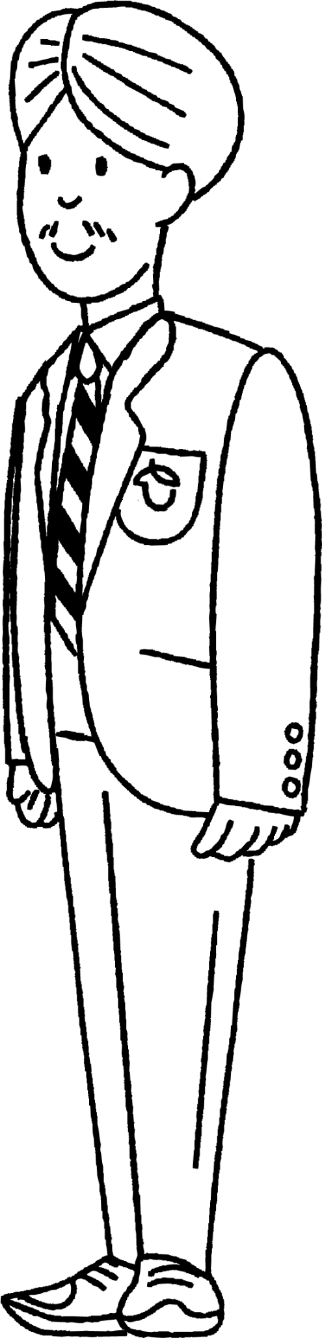
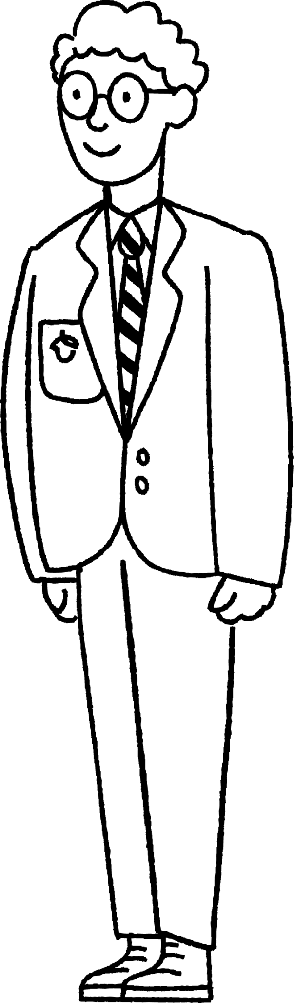
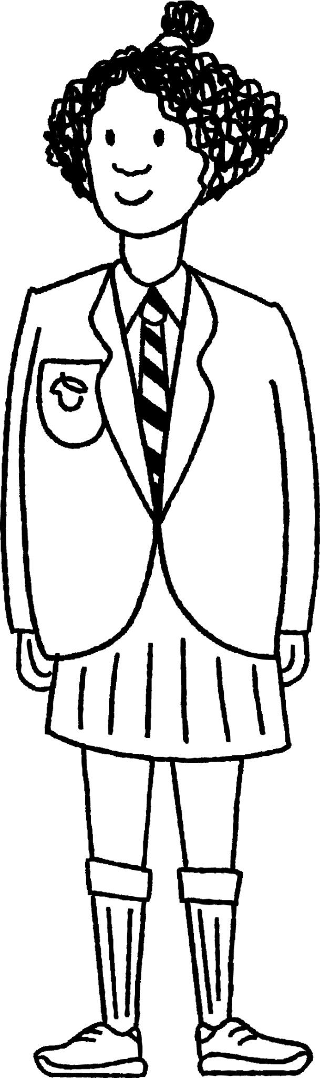
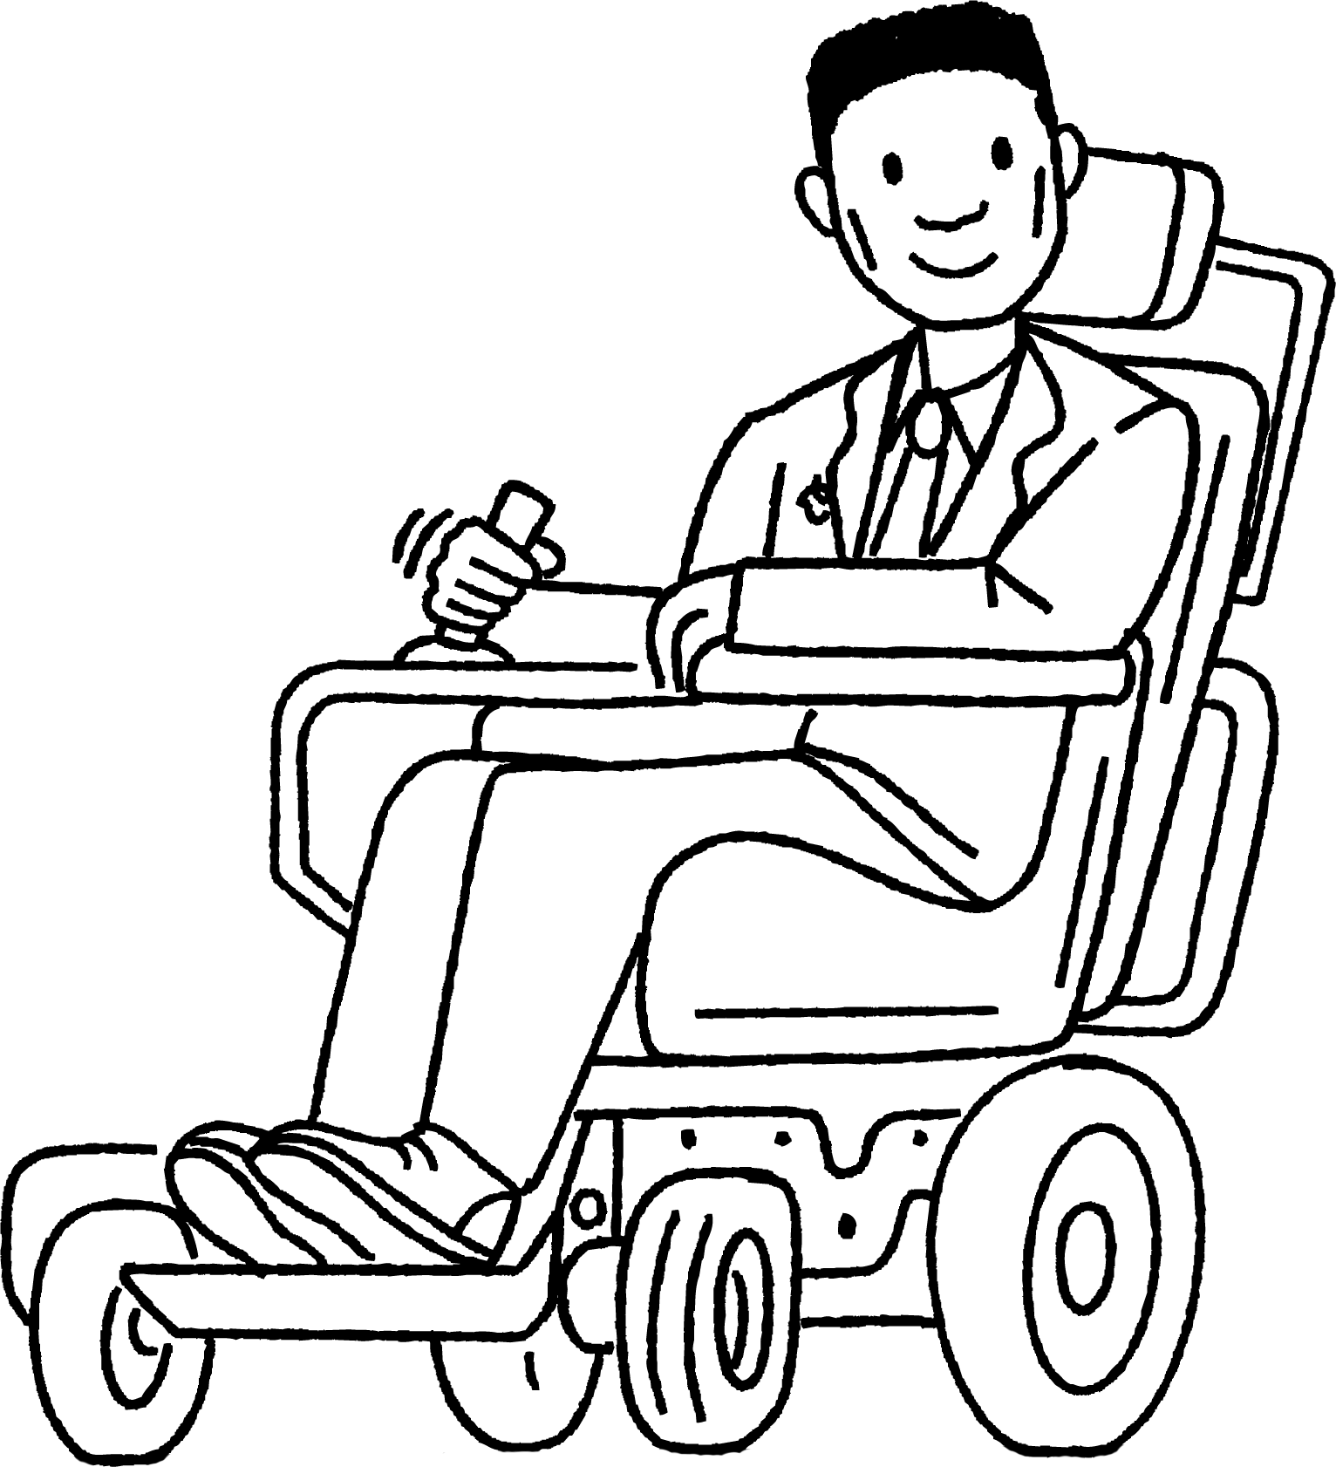
Checking understanding of ordering and comparing numbers
Task B: Comparing numbers using ≤ and ≥
Laura invites her friends out for her birthday. At the theme park you get half price entry if you are under 1.5 m tall.
1) Complete the mathematical statement to describe the situation:
2) Who will get half price entry?
height
1.5 m
Laura wants to ride a big roller coaster. It says you have to be at least 1.45 m tall to ride it.
3) Write a mathematical statement to describe this.
4) Who can ride on the roller coaster?
1.45 m
After visiting the theme park Laura is going to the cinema to watch a film that has a rating of 12.
5) Write a mathematical statement to describe this.
6) Is Laura’s choice of film a good one if she wants her friends to come along? Can you justify your answer?
Sofia 1.44 m Age 11.75
Laura 1.54 m
Age 12
Andeep1.49 m
Age 11
Alex
1.53 m
Age 11.5
Lucas
1.5 m
Age 11.25
Izzy
1.45 m Age 11.5
Mathematics in Education and Industry
2
v2.1

